Slide 1
Problem identification
Big Mountain Resort, a ski resort located in Montana with views, 105 trials to national park and forest for 350,000 people every year. Management has recently installed an additional chair lift to help increase the distribution of visitors across the mountain for $1,450,000. It is desirable to work with pricing strategy in order to cover the cost in a year.

Slide 2
Recommendation and key findings
First, the original data is collected organized and well defined through pandas, matplotlib and seaborn. During this process, the data is pulled to python and define its features, it has 277 rows and 25 columns after data cleaning, it is possible now to locate Big Mountain Resort data in row 151. Also, data without price or missing is dropped from database. The ticket price of weekend and weekday are positively correlated based on the scatter plot for both prices.
Second, by exploring the data, additional US population and size data with which to augment the dataset. These data also need some cleaning. Some information such as total state area, total state population, resorts per state, total skiable area, etc. are found there. Then the ranking for top states by resort density is located. There’s a pattern suggests of a relationship between state and ticket price are some columns located such as summit_elev, vertical_drop, etc.
Third, considering that predicting the adult weekend ticket price is the primary aim of this process. Missing price data is deleted. Mean value is considered here as a predictor. Big Mountain data is extracted and its mean value for ticket price is calculated which is about 63.8. By estimating it with R square metrics, tests, linear regression model and random forest model, final model is selected as random forest model since it has better outcome with mean absolute error. It also exhibits less variability.

Slide 3
Modeling results and analysis
Calculate Expected Big Mountain Ticket Price From The Model
Big Mountain Resort modelled price is $108.30, actual price is $81.00.
Even with the expected mean absolute error of $10.24, this suggests there is room for an increase.
Business provided options incluede:
Permanently closing down up to 10 of the least used runs. This doesn't impact any other resort statistics.
Increase the vertical drop by adding a run to a point 150 feet lower down but requiring the installation of an additional chair lift to bring skiers back up, without additional snow making coverage
Same as number 2, but adding 2 acres of snow making cover
Increase the longest run by 0.2 mile to boast 3.5 miles length, requiring an additional snow making coverage of 4 acres

Slide 4
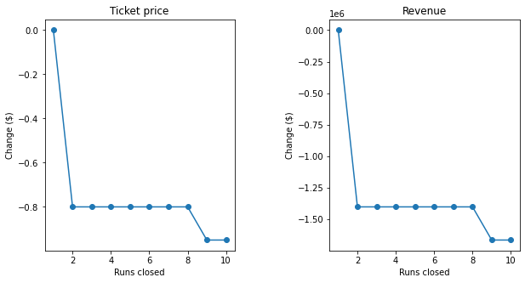
Two plots were created for the predicted ticket price change (delta) for each
condition (number of runs closed) in the scenario and the associated predicted revenue
The model says closing one run makes no difference. Closing 2 and 3 successively reduces support for ticket price and so revenue. If Big Mountain closes down 3 runs, it seems they may as well close down 4 or 5 as there's no further loss in ticket price. Increasing the closures down to 6 or more leads to a large drop.

Slide 5
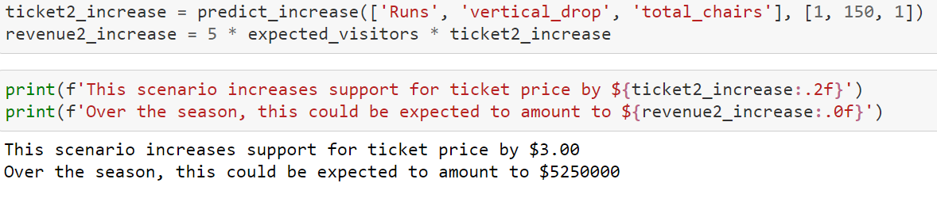
Big Mountain is adding a run, increasing the vertical drop by 150 feet, and installing an additional chair lift.
Here is the option with its results come from the model.

Slide 6
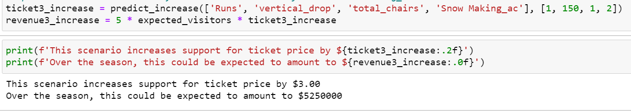
In this scenario, Big Mountain is adding a run, increasing the vertical drop by 150 feet, installing an additional chair lift, also adding 2 acres of snow making.
Such a small increase in the snow making area makes no difference!

Slide 7
Summary and conclusion
To sum up the modeling and its results, here comes up a summary:
After 4 modeling scenarios, the solution is closing down 5 used runs, increase the vertical drop by adding a run to a point 150 feet lower down but requiring the installation of an additional chair lift to bring skiers back up, without additional snow making coverage and Increase the vertical drop by adding a run to a point 150 feet lower down but adding 2 acres of snow making cover.

